Slide 1

LOCATION TYPE TRIP RATES
VARIATION IN TRICS
OWEN EDWARDS
TRICS CONSORTIUM

Slide 2
Often brought up by users requesting guidance on trip rates survey samples
TRICS has undertaken an analysis to feed into an update on our guidance for users
OWEN EDWARDS
TRICS CONSORTIUM

Slide 3
New research began in 2018, looking at regional trip rates variation
Current research in 2019 has looked at location type trip rates variation
A technical note will be produced later this year to cover both aspects
OWEN EDWARDS
TRICS CONSORTIUM

Slide 4
2018 research indicated no evidence for fundamental direct influences on trip rates, with only minor and inconsistent variations identified which may have a variety of causes
A number of other factors can influence trip rates variation, such as location type, local population, public transport levels, etc
OWEN EDWARDS
TRICS CONSORTIUM

Slide 5
TRICS
LOCATION TYPES
OWEN EDWARDS
TRICS CONSORTIUM

Slide 6
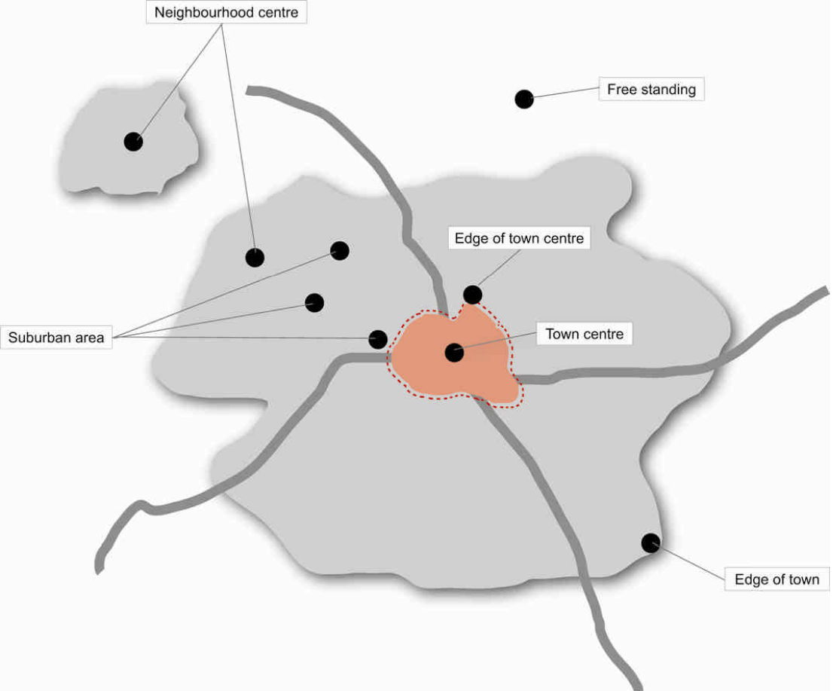
OWEN EDWARDS
TRICS CONSORTIUM

Slide 7
Looking at the largest survey sample possibilities results in three major location types to focus on
1 Town Centre/Edge of Town Centre
2 Suburban Area
3 Edge of Town
OWEN EDWARDS
TRICS CONSORTIUM

Slide 8
LAND
USES
OWEN EDWARDS
TRICS CONSORTIUM

Slide 9
Most popular land uses selected
01/A Food Superstore
02/A Office
03/A Houses Privately Owned
OWEN EDWARDS
TRICS CONSORTIUM

Slide 10
01/A Food Superstore split into Friday only and Saturday only surveys
02/A Office and 03/A Houses Privately Owned will use only weekday surveys
OWEN EDWARDS
TRICS CONSORTIUM

Slide 11
SELECTION
PARAMTERS
OWEN EDWARDS
TRICS CONSORTIUM

Slide 12
As many surveys wanted to keep the samples as large as possible
Vehicles Only surveys
Looking at surveys from the past 20 years, minimum date set to 01/01/1999
OWEN EDWARDS
TRICS CONSORTIUM

Slide 13
01/A FOOD SUPERSTORE FRIDAY RESULTS
OWEN EDWARDS
TRICS CONSORTIUM

Slide 14
01/A FOOD SUPERSTORE FRIDAY
TRICS Location Types | Surveys (59) | Peak Totals (11.661)
3 Edge of Town | 26 | 12.542
2 Suburban Area | 20 | 11.510
1 Town Centre/Edge of Town Centre | 13 | 9.757
Results per 100m²
OWEN EDWARDS
TRICS CONSORTIUM

Slide 15
01/A FOOD SUPERSTORE FRIDAY
TRICS Location Types | Surveys (59) | Trips Totals (139.976)
3 Edge of Town | 26 | 149.839
2 Suburban Area | 20 | 141.898
1 Town Centre/Edge of Town Centre | 13 | 102.822
Results per 100m²
OWEN EDWARDS
TRICS CONSORTIUM

Slide 16
This sample shows Edge of Town with generally higher trip rates for both peak totals and trips totals
Town Centre/Edge of Town Centre shows generally lower trip rates for both peak totals and trips totals
OWEN EDWARDS
TRICS CONSORTIUM

Slide 17
01/A FOOD SUPERSTORE SATURDAY RESULTS
OWEN EDWARDS
TRICS CONSORTIUM

Slide 18
01/A FOOD SUPERSTORE SATURDAY
TRICS Location Types | Surveys (78) | Peak Totals (12.675)
3 Edge of Town | 34 | 13.396
2 Suburban Area | 28 | 12.007
1 Town Centre/Edge of Town Centre | 17 | 11.802
Results per 100m²
OWEN EDWARDS
TRICS CONSORTIUM

Slide 19
01/A FOOD SUPERSTORE SATURDAY
TRICS Location Types | Surveys (78) | Trips Totals (142.637)
3 Edge of Town | 34 | 145.308
2 Suburban Area | 28 | 142.528
1 Town Centre/Edge of Town Centre | 17 | 120.902
Results per 100m²
OWEN EDWARDS
TRICS CONSORTIUM

Slide 20
These data samples show a similar pattern of results to the 01/A Food Superstore Friday results
Edge of Town shows generally higher trip rates with Town Centre/Edge of Town Centre showing generally lower trip rates
OWEN EDWARDS
TRICS CONSORTIUM

Slide 21
02/A OFFICE
WEEKDAY RESULTS
OWEN EDWARDS
TRICS CONSORTIUM

Slide 22
02/A OFFICE WEEKDAY
TRICS Location Types | Surveys (130) | Peak Totals (0.734)
3 Edge of Town | 28 | 0.997
2 Suburban Area | 29 | 0.714
1 Town Centre/Edge of Town Centre | 73 | 0.601
Results per 100m²
OWEN EDWARDS
TRICS CONSORTIUM

Slide 23
02/A OFFICE WEEKDAY
TRICS Location Types | Surveys (130) | Trips Totals (10.771)
2 Suburban Area | 29 | 11.813
3 Edge of Town | 28 | 11.222
1 Town Centre/Edge of Town Centre | 73 | 7.690
Results per 100m²
OWEN EDWARDS
TRICS CONSORTIUM

Slide 24
Peak totals show a similar pattern of results to both 01/A Food Superstore sets of results
However, trips totals show Suburban Area having slightly higher trip rates than Edge of Town
OWEN EDWARDS
TRICS CONSORTIUM

Slide 25
03/A HOUSES PRIVATELY OWNED WEEKDAY RESULTS
OWEN EDWARDS
TRICS CONSORTIUM

Slide 26
03/A HOUSES PRIVATELY OWNED
TRICS Location Types | Surveys (192) | Peak Totals (0.595)
3 Edge of Town | 90 | 0.616
2 Suburban Area | 81 | 0.574
1 Town Centre/Edge of Town Centre | 21 | 0.560
Results per dwelling
OWEN EDWARDS
TRICS CONSORTIUM

Slide 27
03/A HOUSES PRIVATELY OWNED
TRICS Location Types | Surveys (192) | Trips Totals (6.975)
3 Edge of Town | 90 | 7.102
1 Town Centre/Edge of Town Centre | 21 | 5.766
2 Suburban Area | 81 | 5.010
Results per dwelling
OWEN EDWARDS
TRICS CONSORTIUM

Slide 28
Peak totals show a similar pattern of results to all 01/A Food Superstore and 02/A Office sets of results
Trips totals show Suburban Area having slightly lower trip rates than Town Centre/Edge of Town Centre
OWEN EDWARDS
TRICS CONSORTIUM

Slide 29
CROSS LAND
USE RESULTS
OWEN EDWARDS
TRICS CONSORTIUM

Slide 30
CROSS LAND USE RANKINGS
TRICS Location Types | 01/AF | 01/AS | 02/AW | 03/AW
1 Town Centre/Edge of Town Centre | 3rd | 3rd | 3rd | 3rd
2 Suburban Area | 2nd | 2nd | 2nd | 2nd
3 Edge of Town | 1st | 1st | 1st | 1st
Based on Peak Totals (Ranked Highest to Lowest)
OWEN EDWARDS
TRICS CONSORTIUM

Slide 31
CROSS LAND USE RANKINGS
TRICS Location Types | 01/AF | 01/AS | 02/AW | 03/AW
1 Town Centre/Edge of Town Centre | 3rd | 3rd | 3rd | 2nd
2 Suburban Area | 2nd | 2nd | 1st | 3rd
3 Edge of Town | 1st | 1st | 2nd | 1st
Based on Trips Totals (Ranked Highest to Lowest)
OWEN EDWARDS
TRICS CONSORTIUM

Slide 32
Different land uses give reasonably similar results
Variation in rankings is minimal and strong consistencies are apparent
OWEN EDWARDS
TRICS CONSORTIUM

Slide 33
Using the four data samples, it is possible to view each location type’s variance ranges from the average of all surveys
The two tables are based on total peak figures and total trips figures
OWEN EDWARDS
TRICS CONSORTIUM

Slide 34
TRIP GENERATION RANGES SUMMARY
TRICS Location Types | Surveys | High | Low | Average
1 Town Centre/Edge of Town Centre | 124 | -5.9% | -18.1% | -11.8%
2 Suburban Area | 158 | -1.3% | -5.3% | -3.2%
3 Edge of Town | 178 | +35.8% | +3.5% | +13.2%
Total Peak figures
OWEN EDWARDS
TRICS CONSORTIUM

Slide 35
TRIP GENERATION RANGES SUMMARY
TRICS Location Types | Surveys | High | Low | Average
1 Town Centre/Edge of Town Centre | 124 | -15.2% | -28.6% | -21.9%
2 Suburban Area | 158 | +9.7% | -28.2% | -4.3%
3 Edge of Town | 178 | +7.0% | +1.8% | +3.7%
Total Trips figures
OWEN EDWARDS
TRICS CONSORTIUM

Slide 36
The average variance tables show Edge of Town surveys have higher than average trip rates
Suburban Area surveys tend to have slightly lower than average trip rates
Town Centre/Edge of Town Centre have lower than average trip rates
OWEN EDWARDS
TRICS CONSORTIUM

Slide 37
LOCATION TYPE TRIP RATES VARIATION FINDINGS
OWEN EDWARDS
TRICS CONSORTIUM

Slide 38
These findings indicate location type variance produces a much more pronounced influence over trip rates than regional variance
The regional variance findings showed only minor and inconsistent variations which may have a variety of causes
OWEN EDWARDS
TRICS CONSORTIUM

Slide 39
Location type results for each of the four land use category variations tended to produce similar results
This indicates location type can be one of the more significant factors when it comes to influencing trip rates
OWEN EDWARDS
TRICS CONSORTIUM

Slide 40
TRIP RATES
INFLUENCES
OWEN EDWARDS
TRICS CONSORTIUM

Slide 41
Instead of deselecting a region, ask why you have made a regional presumption about its trip rates
TRICS includes parameters for location type, local populations, public transport pass-bys, car ownership levels, etc
OWEN EDWARDS
TRICS CONSORTIUM

Slide 42
FURTHER
WORK
OWEN EDWARDS
TRICS CONSORTIUM

Slide 43
Following on from this second piece of research, the findings of both pieces will be combined to create a new Regional and Location Technical Note later this year
OWEN EDWARDS
TRICS CONSORTIUM

